Slide 1
Badminton Swing Analyzer
using
MPU6050
Batch –B2
Team Members
Aswin Raaj .R
Mani Balaji .S
Tharun .V.S
Guided by
Dr.G.Pandiaraj
Assistant Professor (Sl. Grade)
Electrical and Electronics Engineering

Slide 2
Problem Statement:
Players lack affordable swing analytics tools
Existing solutions are costly
Objective:
To design a low-cost badminton swing analyzer utilizing
MPU6050 and ESP32 MCU
To support players in improving their skills through measurable swing parameters and visual feedback of performance

Slide 3
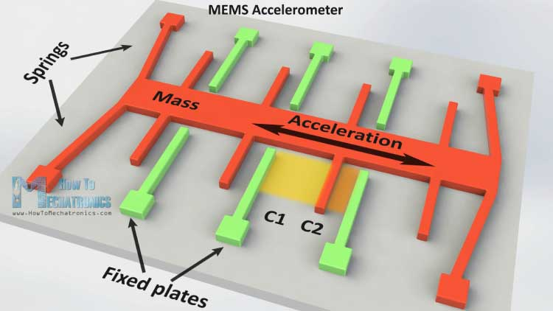
Working of MPU 6050
IMU – Measures body's specific force, angular rate, using accelerometers, gyroscopes .Used in robotics, aerospace, and motion tracking in sports
MPU6050 uses MEMS technology - 6 axis motion tracking device( 3-axis accelerometer, 3-axis gyroscope, temperature sensor and DMP)
Accelerometer – measures(static and dynamic acc) , capacitive sensing – variation of C = applied acc.
AD: high accuracy, low power consumption

Slide 4
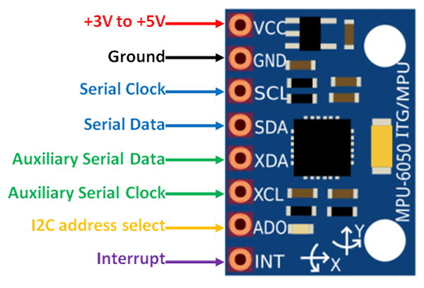
Gyroscope – measures orientation and ang.V, Variation of C= applied ang.rate
Follows Coriolis Effect . Have 4 proof mass – detect roll(x) ,pitch(y), yaw(z)
When mass moves in spec. direction with V and ext. ang. Rate applied – produce -Coriolis Effect .- generates a force – moves in perpendicular direction
MPU6050 sensor
Similar sensors: ADXL345 , MPU9250

Slide 5
Research papers overview
S.no | 1 | 2
Research Paper Title | Design of angle detection system based on MPU6050 | Vibration detection prototype Using MPU6050
Key findings | Effective in detecting angles | Effective in detecting vibrations
Limitation | Need for calibration in different conditions | Interference of noise
What we improve in our project | Get offset values of racket position by keeping it stable for 3s (approx. 3000samples) | Using Kalman filter, reduce sensor drift and noise interference
http://www.jurnal.nips.ru/sites/default/files/A&SE-1-2015-11_0.pdf
https://ijsrst.com/home/issue/view/article.php?id=IJSRST52310620

Slide 6
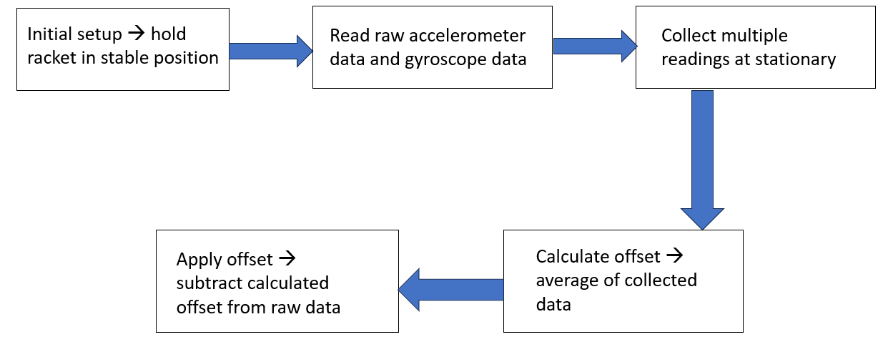
Calibration of sensor

Slide 7
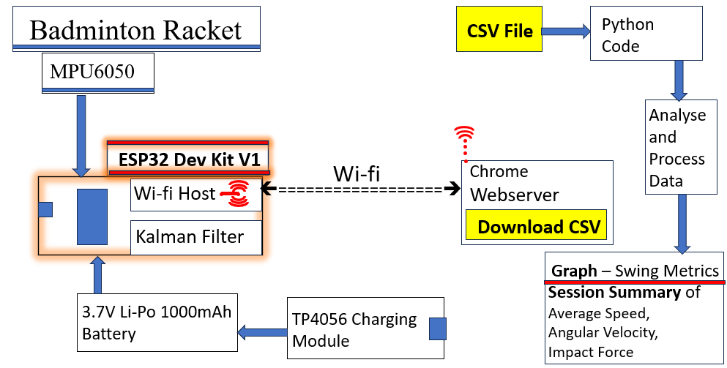
Block Diagram

Slide 8
Swing Metrics to be measured
S.no | Swing Metrics | Need
1. | Swing speed (km/hr) – from acc.data | To measure swing speed
2. | Peak angular velocity(deg/s) – from gyro.data | To measure fastness of swing
3. | Impact force (m/s^2) | Solidness of the hit

Slide 9
^{Bill of Materials and Cost}
S.no | Components | Weight in g | Price(rs) (approx.)
1. | MPU6050 sensor | 3-4 | 500
2. | ESP32 DEVKIT V1 | 10 | 600
3. | TP4056 Charging Module | 3-5 | 50
4. | 3.7V 1000mAh Li-po Battery | 20 | 300
5. | Badminton Racket -Hardware | 80
 | Total | 80+36=116g | 1450rs
Approx. price = 1500rs

Slide 10
Prototype Design
MPU 6050
ESP32 MCU and 3.7V Li-Po battery
TP4056 charging module

Slide 11
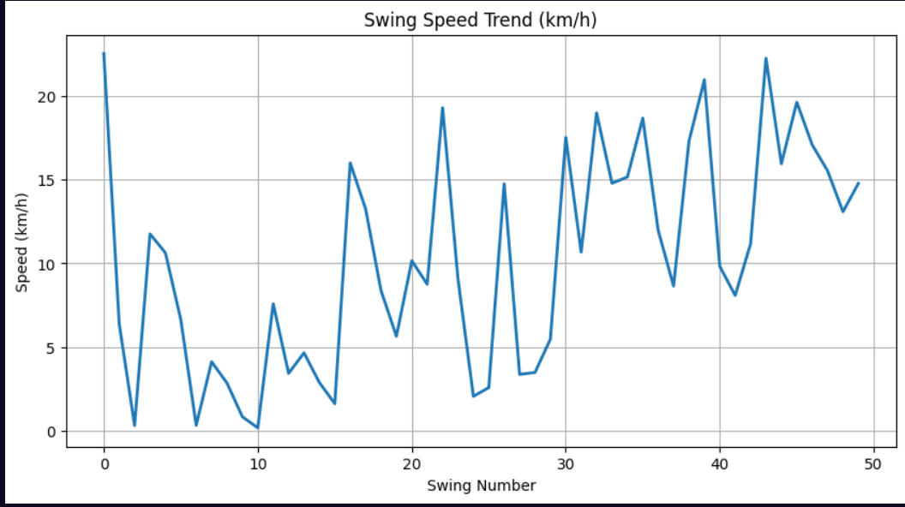
Swing Speed Graph

Slide 12
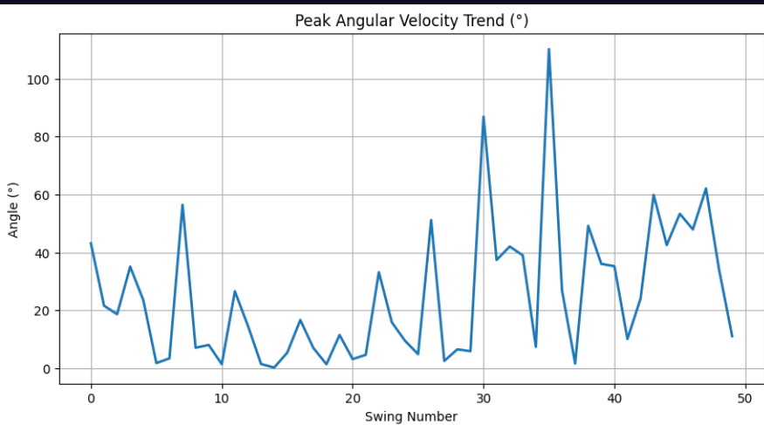
Angular Velocity Graph

Slide 13
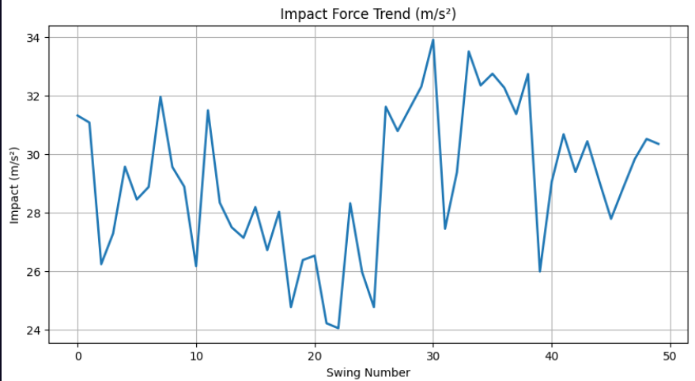
Impact Force Graph

Slide 14
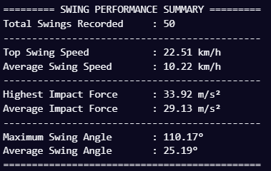
Session Summary

Slide 15
Challenges
Sensor Drift and Noise interference
Power Consumption
Calibration complexity

Slide 16
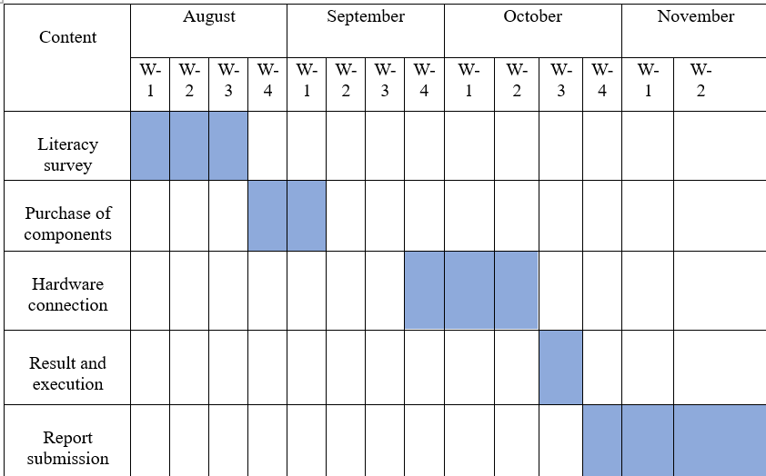
Gantt Chart

Slide 17
References
Rodrigues, João Victor Oliveira, et al. "Performance evaluation of accelerometers ADXL345 and MPU6050 exposed to random vibrational input." Research, Society and Development 10.15 (2021): e286101523082-e286101523082.
Fedorov, D. S., et al. "Using of measuring system MPU6050 for the determination of the angular velocities and linear accelerations." Automatics & Software Enginery 11.1 (2015): 75-80.
Jacob, Alvin, Wan Nurshazwani Wan Zakaria, and Mohd Razali Bin Md Tomari. "Implementation of IMU sensor for elbow movement measurement of badminton players." 2016 2nd IEEE International Symposium on Robotics and Manufacturing Automation (ROMA). IEEE, 2016.
Li, Li, and Feng Li. "Recognizing badminton hitting movements Based on Multi-sensor trajectory recognition algorithm." 2023 3rd International Conference on Information Technology and Contemporary Sports (TCS). IEEE, 2023.
https://ijsrst.com/home/issue/view/article.php?id=IJSRST52310620
https://pubmed.ncbi.nlm.nih.gov/38580698/
http://www.jurnal.nips.ru/sites/default/files/A&SE-1-2015-11_0.pdf

Slide 18
Thank You

